Slide 1
Audio File formats
CS425

Slide 2
Wav Files – Uncompressed and Lossless
Waveform audio files (also called WAV files) are one of the more popular digital audio formats and a gold standard in studio recording. WAV was one of the first digital audio formats. It still maintains its position as one of the world’s leading pro audio formats.
WAV files capture and recreate an original audio waveform at the highest quality without affecting or altering the sonic characteristics of the sound in any way. WAV uses PCM (Pulse Code Modulation) to encode the data by slicing it into small chunks to provide the highest quality possible.
It’s a lossless file format, meaning that there is no data loss whatsoever. So what gets captured and recorded is the closest representation of the original audio waveform—no noticeable audio quality loss happens in the process.
WAV files are also uncompressed, meaning that the data is stored as-is in full original format that doesn’t require decoding. This provides enormous versatility allowing for editing and manipulation.

Slide 3
Aiff – Uncompressed and Lossless
AIFF (Audio Interchange File Format) was created soon after WAV and works identically: it provides studio-grade audio recording and playback. Offering sample rate and bit depth options just like WAV files, AIFF registers the audio waveform as accurate samples using PCM. Just like WAV, AIFF also stores data in uncompressed, lossless format.
So what’s the difference between them? WAV was created from a partnership between Microsoft Windows and IBM, so WAV files played back natively only on Windows machines. AIFF, on the other hand, was Macintosh’s response to WAV files, allowing full studio-quality audio recording and playback on Apple computers. Nowadays both formats can be recorded and played back natively on any operating system, so they’re easily interchangeable, offering the same high-quality audio, regardless of format.

Slide 4
MP3 – Compressed and Lossy
Uncompressed audio formats like WAV and AIFF provide great sound quality, but at the cost of high file size. With the rapid growth of internet file-sharing in the mid-90s, people quickly realized that sending uncompressed files over dial-up connections was impractical—and oftentimes impossible. Which is why MP3s (MPEG-2 Audio Layer III) quickly grew in popularity.
While a three-minute song would average 30MB in WAV or AIFF format, that same song converted to MP3 would take up a tenth of the space—only around 3MB. With compression algorithms that were capable of achieving impressively small file sizes, MP3 became a staple of the internet era and has maintained its strong position to date.

Slide 5
MP3
However, small file size came at the cost of sound quality.
Different compression formats use varying methods to re-encode the data in a way that saves space. But this saving of space means some data has to get lost in the process. Usually, high frequencies are the first ones to go, as the majority of people can’t hear the details in really high frequencies. The lower the encoding quality, the more frequencies and details will get lost in the audio.
However,, modern compression algorithms allow for higher bitrates, which, in turn, means that they’re able to achieve high compression ratios with little noticeable loss to the quality of the audio. Bitrate represents the amount of data conveyed per second of audio content, with the general rule of thumb being: smaller bitrates = smaller file sizes. So if you want to maintain good quality, yet still make use of the fact that MP3s are easy to share with friends and family, keep your bitrate above 128Kbps (kilobits per second).

Slide 6
M4A – Compressed and Lossy
M4A (MPEG-4 Part 14) files were Apple’s response to MP3s. Often seen as the successor to the MP3, this Mac-centric compressed audio format found its true place with the birth of the iTunes Store, where it became the primary format for all music purchases made through the online music store. It is still the preferred format for all audio included in apps that are released on the Mac and iOS App Stores, as well as Nintendo and PlayStation products. With more and more developers including support for M4A, it’s quickly becoming the go-to audio format for compressed audio files.
M4A files are encoded with the lossy Advanced Audio Coding (AAC) codec, which is able to provide the same bitrates as MP3s, yet achieve tighter compression. This results in smaller file sizes, all while delivering higher audio quality. It’s like a golden unicorn, which is why it’s become such a popular format for light-weight audio deliveries.
Although many audio players can playback M4A files across various platforms, the audio format still can’t compete with MP3’s universal compatibility, which is why MP3s still rule the world due to their cross-platform adoption.

Slide 7
FLAC
FLAC (Free Lossless Audio Codec) is a musical file format that offers bit-perfect copies of CDs but at half the size. It is compatible with many devices.
One of the best FLAC players available is Roon, a high-end music player for PC and Mac.
FLAC first emerged in 2001 as an open-source alternative to other lossless formats emerging at the time. These included Apple Lossless (ALAC), Microsoft's WAV (Waveform Audio Format) and WMA Lossless.

Slide 8
FLAC
The biggest problems with Wav are that file sizes are very large, and it does not offer as rich a range of metadata tags in the way the other such as FLAC formats can.

Slide 9
Uncompressed lossless
If you’re working on releasing your song publicly, you’ll want to bounce it in an uncompressed audio format, that way your original master export is at the highest uncompromised quality possible. Additionally, following the Red Book standard to provide for the ultimate listening experience, CD-quality audio should use uncompressed audio files at 44.1kHz and 16-bit depth. The simple way to think of this is: if you need to share your music in a way that doesn’t jeopardize the quality of your music in any way, use an uncompressed audio format. So both WAV and AIFF will be your best friends here.
PROS: Studio audio quality without compromise CONS: Large File Size that can be troublesome when trying to share digitally or via email

Slide 10
Compressed lossy
On the other hand, if your intent is to make sharing your music easy and fast, choose a compressed audio format that will provide you with small file size. Yes, it will mean you’ll have to trade perfect quality away, but if you know that the person you’re sending your song to is going to be listening on headphones on a bus or their car audio system, then you know that extreme audio quality won’t matter. At that point, convenience will always win. Additionally, since email providers limit attachment sizes and smartphones have limited storage space, any audio format that can offer smaller file sizes is going to be a winner. For all of those instances, choose a compressed audio format like MP3 or M4A.
PROS: Small file size, perfect for sending via email, direct messages, or storing on mobile devices CONS: To achieve smaller files, audio quality is compromised. The smaller the file, the worse the audio quality will be.

Slide 11
Wav Vs AIFF
So if WAV and AIFF can both offer the same highest studio-quality audio, which one should you choose? Well, that will really depend on your use case. For starters, the historical prevalence still stands today. WAV files are more popular on Windows, whereas AIFF files keep their ground on Macs. If you’re planning to send your audio files to the studio for further overdubbing or mixing, consistency with your session is important, so talk with your sound engineer about what format they plan to use in the session, and make sure your audio bounces match. The great news is, regardless of which of the two formats you choose, you will achieve exactly the same superb audio quality.

Slide 12
MP3 vs M4A
The majority of desktop and mobile devices sold nowadays come with native support for MP3 and M4A files alike. For higher quality results, I recommend you choose M4A, which can offer higher sonic results at the same settings, all while still resulting in smaller file sizes than MP3. On the other hand, if guaranteed compatibility is what you need most, MP3 will probably be the wiser choice of the two.

Slide 13
Compare FLAC and MP3
MP3 is a lossy format, which means that information of the music is discarded to reduce the file size to a more compact level.
It uses algorithms derived from "psychoacoustics" to delete redundant sounds, but it isn't always successful. Typically, cymbals, reverb and guitars are the sounds most affected by MP3 compression and can sound really distorted or "crunchy" when too much compression is applied.
FLAC doesn't have the auditory problems of MP3s. FLAC is lossless and more like a ZIP file -- it comes out sounding the same when it is unzipped.

Slide 14
Compare FLAC and MP3
While FLAC files are up to six times larger than an MP3, they are half the size of a CD, and can have the same boost in audio quality.
Furthermore, FLAC is not just restricted to 16-bit (CD quality), and files can be bought up to 24-bit/192kHz for better performance.

Slide 15
Which Format to use?

Slide 16
CS425
Introduction to Frequency Analysis

Slide 17
Frequency Analysis
The fundamental idea is that while a signal may be difficult to understand/analyse by looking at its time waveform, its frequency spectrum should reveal much more information about how it is formed.

Slide 18
Frequency Analysis and Hearing
This fits with how humans perceive sound: the mechanism of the inner ear converts fluctuations in air pressure into mechanical energy first of all.
The eardrum vibrates, which in turn causes a series of three tiny bones (the hammer, the anvil, and the stirrup) in the middle ear to vibrate. The vibration is transferred to the snail-shaped cochlea in the inner ear.

Slide 19
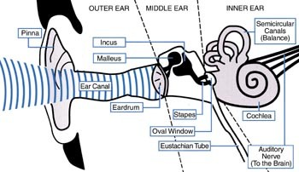
The Ear

Slide 20
Functioning of the Ear
This vibration is then transferred along the basilar membrane of the cochlea, and converted to nerve impulses by the hair cells in the cochlea
The nerve impulses reach the auditory processing areas in the central nervous system, which recognize the sound and integrate this knowledge with information from other sensory modalities (e.g., vision).

Slide 21
Functioning of the Ear
It is thought that the cochlea functions to separate incoming acoustic frequencies by responding to different frequencies in different spatial locations along its length.
The belief is that each region on the basilar membrane acts as a filter bank

Slide 22
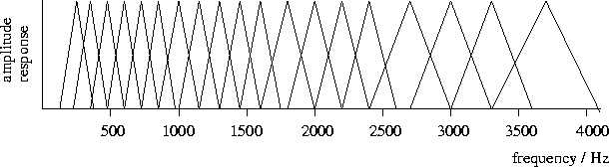
Filterbank
A filterbank is a set of filters arranged such that each has a different centre frequency and passes spectral energy from different spectral regions

Slide 23
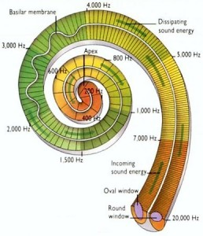
Filterbank Behaviour of Basilar Membrane

Slide 24
Filterbank/ Spectrum Analyser
A spectrum analyser is a tool for discovering and examining the individual energies of the set frequency components that make up a signal
A specific set of frequencies should be selected by the user. However, in many cases the default approach is to just pick a set of equally spaced frequencies.
Once this is done, the analyser isolates and measures the energy around each frequency

Slide 25
Bandpass Filter - Radio Dial
An example of a tunable bandpass filter that most people have used is the dial on a radio
The bandpass filter is designed to let the frequencies associated with one radio station only though and eliminate all others.
Manually we move the centre frequency of the bandpass filter via the dial to find the radio station we are looking for.

Slide 26
Bandpass Filters – Spectrum Analysis
The job of spectral analysis can be carried out using bandpass filters.
Isolating each frequency of interest is ideally suited to a BandPass Filter (BPF) with a narrow passband
After passing signal through the BPF, we can then measure the energy at its output

Slide 27
Example Bandpass Filter Frequency Response

Slide 28
Bandpass Filters
Channel N-1
Channel k
x[n]
Channel 0
Block diagram of a Spectrum analyser

Slide 29
Fourier Theory
The principle of the spectrum analyser is described by Fourier theory
This explains in theory how to compute the spectrum of a signal
Using Fourier’s equation we can find the frequency spectrum of any signal we can describe mathematically

Slide 30
Fourier Theory
Fourier was a French mathematician that made a fundamental contribution to frequency analysis
He came up with his theory in the 19th century
In essence, he said that it is possible to form any periodic function f(t) from the summation of a series of sine and cosine terms of increasing frequency

Slide 31
Sawtooth Example

Slide 32
Constituent Sinewaves for Sawtooth

Slide 33
Constituent Sinewaves for Sawtooth

Slide 34
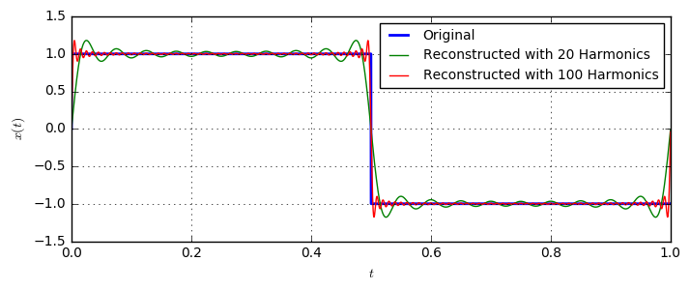
Square wave and harmonics

Slide 35
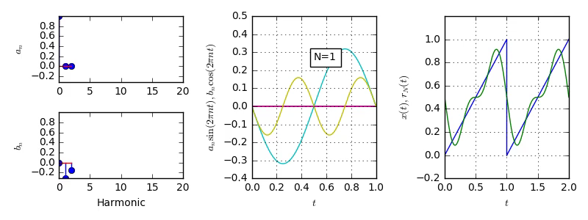
Sawtooth
Notes:
https://dspillustrations.com/pages/posts/misc/fourier-series-and-harmonic-approximation.html

Slide 36
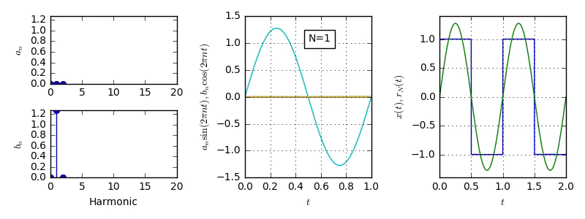
Square wave

Slide 37
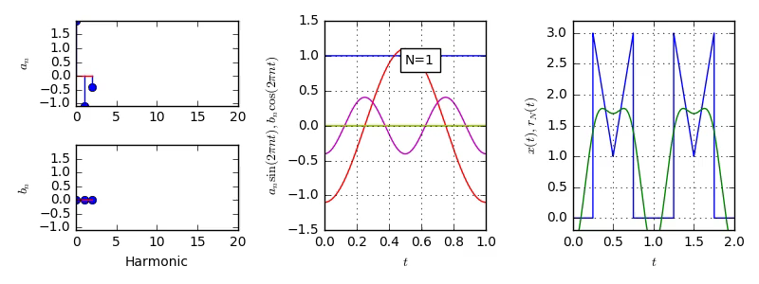
Double triangle

Slide 38
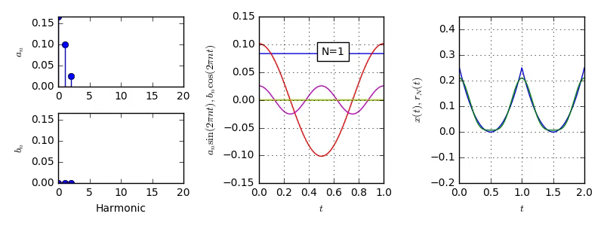
Parabola Signal

